Slide 1
Wyoming Community Health Centers
Select Committee on Family Residency Medicine Programs
Over 20 Years of
Building Healthier Communities

Slide 2
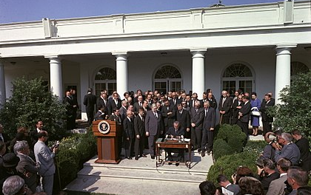
About Health Centers
Community Health Centers are part of the healthcare safety net which also includes Rural Health Clinics and Free Clinics
50+ year program, the first two health centers are still open today
Health Centers enjoy bipartisan support, the number of health centers doubled under President H. W. Bush
The Bipartisan Budget Act of 2018 increased funding to Health Centers
President Lyndon B. Johnson signs the Economic Opportunity Act in 1964” which enabled Drs. Geiger and Gibson to introduce the idea of “Neighborhood Health Centers” which was approved and became an official federal program in 1965.
Over 20 Years of
Building Healthier Communities

Slide 3
Terminology
FQHC – Federally Qualified Health Center which is a reimbursement designation from BPHC and CMS term for a Health Center
CHC – Community Health Center is a private, nonprofit organization that directly or indirectly provide primary health services to residents of a defined geographic area that is medically underserved.
FQHC Look Alike – An organization that meets all of the eligibility requirements of a Community Health Center or PHS Section 330 grantee but does not received the grant funding.
Under Section 330 of the Public Health Service Act – the federal legislation creating the Health Center Program – some health centers receive funding to specifically target one of three “special populations” (as defined by the 330 statute):
Section 330(g): Migrant and seasonal farmworkers and their families
Section 330(h): Individuals/persons experiencing homelessness
Section 330(i): Residents of public housing
Over 20 Years of
Building Healthier Communities

Slide 4
Terminology, cont’d…
Medically Underserved Areas/Populations – areas or populations designated by HRSA as having too few primary care providers, high infant mortality, high poverty or a high elderly population. MUA/MUP designations are necessary to be eligible to apply for Health Center funding.
Health Provider Shortage Area – designated by HRSA as having shortages of primary medical care, dental or mental health providers and may be geographic (a county or service area), population (e.g. low income or Medicaid eligible), or facilities (e.g. federally qualified health center or other state or federal prisons).
HRSA – Health Resources and Services Administration, part of Health and Human Services
Over 20 Years of
Building Healthier Communities

Slide 5
Health Centers Requirements
Must see all patients regardless of insurance status or ability to pay, including those at or below 200% FPL whose payments will be determined on a sliding fee scale
Governed by a community Board of Directors, must contain at least 51% health center patients
Must be community driven non-profit focused on all unmet healthcare needs
Required to report patient and staffing information into the Uniform Data System or UDS on an annual basis.
Must meet benchmarks for quality improvement, health outcomes and prevention
Nationally competitive application, eligibility based on unmet need in the community/service area; if awarded have to open clinic within 120 days of award
Once awarded, the Health Center is given a three year grant period before having to compete for the service area again. They will also have an operational site visit (OSV) in each grant period.
Over 20 Years of
Building Healthier Communities

Slide 6
Health Centers Requirements
New compliance manual released in Fall of 2017 outlines 91 program areas that must be met by FQHCs and Look Alikes.
Operational site visits (OSVs) are performed based on those 91 program areas:
Financial – processes to ensure good stewardship of federal and other funds;
Clinical – patients’ access to 24 hour care, preventative testing, etc.
Governance – board makeup, meeting schedule, board minutes and oversight
Non-compliance in program areas is noted as “findings” during the OSV, some of which can be quickly corrected or corrected after a HRSA generated OSV report. If findings are not corrected then, they can become grant conditions, subject to a series of actions that could lead to defunding.
Bipartisan Budget Act of 2018 passed by Congress in March changed statute regarding Health Center compliance. HRSA is no longer permitted to fund Community Health Centers which are out of compliance for more than 2 years, instituting what is being called the one one and done rule giving Health Centers a shorter timeline to become compliant after an OSV.
Over 20 Years of
Building Healthier Communities

Slide 7
Health Center Benefits
Federal grant funds (except for Look Alikes) to help cover the cost of the uninsured/underserved (this is only a portion of their overall cost to provide care which is estimated to be 25% of the budget with the other funds coming from Medicare and Medicaid, private insurance and state/community support)
Access to National Health Service Corps – federal loan repayment programs
Discounted medication program or 340B
Providers can be covered to Federal Tort Claims Act
Additional grant funds like the AIMS grant funds that four Wyoming Health Centers recently received to address opioid and substance abuse disorders (Access Increases for Mental Health and Substance Abuse Services) which has enabled the Health Centers to hire mental health staff
Over 20 Years of
Building Healthier Communities

Slide 8
Health Center locations
Over 20 Years of
Building Healthier Communities

Slide 9
Health Center Model of Care
Multi-disciplinary team of health care professionals
who are engaged in quality improvement activities
(50% of Wyoming’s Health Centers are PCMH recognized)
using health information technology to track and evaluate performance measures
work to ensure that the complex health care needs of their patients are met
Given their patients’ broad health care needs, Health Centers provide services not traditionally seen in other primary care settings
dental, behavioral health and pharmacy
enabling services like case management, outreach, translation, transportation, nutritional assistance programs, insurance enrollment, home visitations, housing assistance, job training and support groups.
Over 20 Years of
Building Healthier Communities

Slide 10
Recruitment and Retention
Community Health Centers have access to National Health Service Corps – federal loan repayment programs
Recruiting support from Wyoming Health Resources Network and the state and regional Primary Care Associations
Providers can be covered to Federal Tort Claims Act
Some of the same challenges in recruiting and retention to rural communities as private practice providers
Provider shortages disproportionately affect rural areas
Smaller Health Centers usually employ a single provider, which causes overwork
People living in rural settings on average have higher rates of chronic illness and poor overall health
Over 20 Years of
Building Healthier Communities

Slide 11
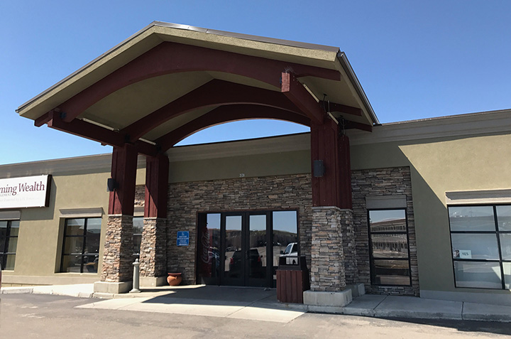
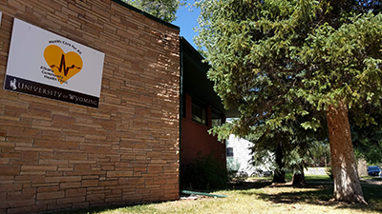
Newest Wyoming Community Health Centers
New Access Point applications from Wyoming were awarded in each of the last three application cycles for Wyoming communities:
Powell Health Care Coalition
Rock Springs Community Health Center – September, 2017
Albany Community Health Clinic – April, 2018
Over 20 Years of
Building Healthier Communities

Slide 12
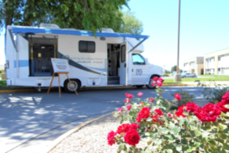
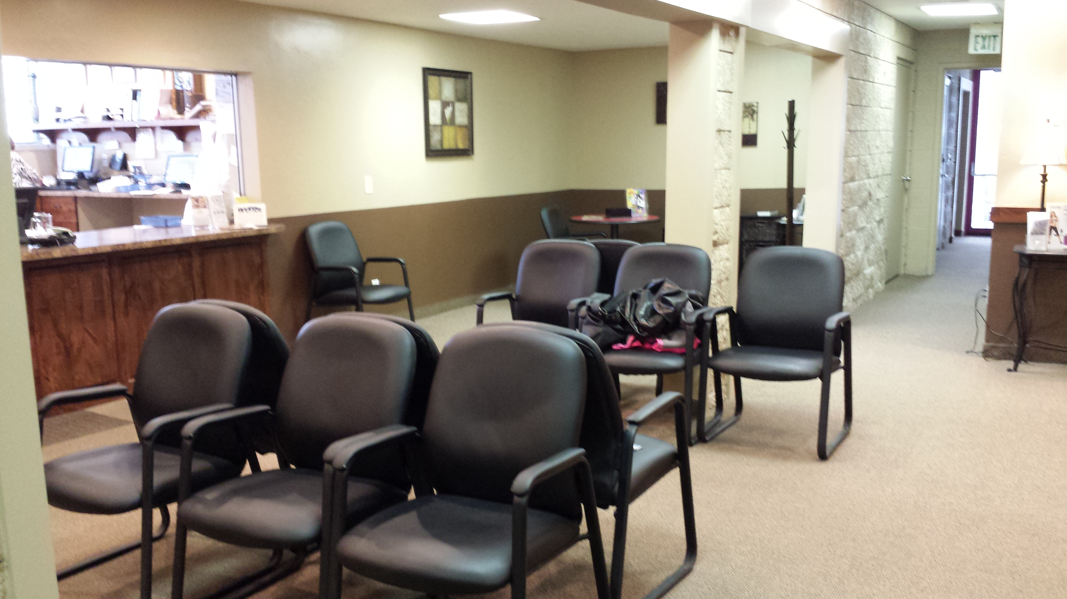
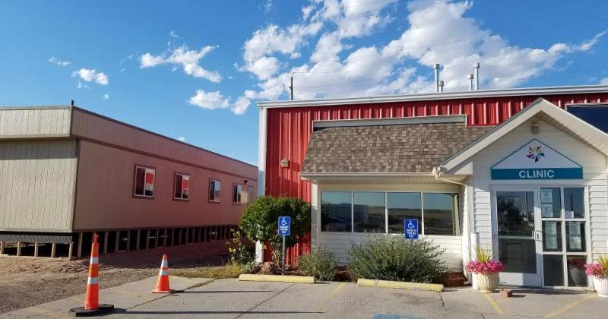
Primary Care Support Grant
State funding
State funding from the Primary Care Support Grant have resulted in major projects in locations around the state. (From left to right): A mobile unit to serve the Big Horn Basin; expanded waiting room, x-ray machine and handicap accessible doors in Evanston; a building to house behavioral health and substance abuse services in Cheyenne and grant writing services which led to the successful application for the Powell Health Center.
Over 20 Years of
Building Healthier Communities

Slide 13
Contact Information
Jan Cartwright
Executive Director
Wyoming Primary Care Association
jan@wypca.org
307-632-5743
Over 20 Years of
Building Healthier Communities

